Slide 1

Visual Question-Answering
Team Members:
Abdalla Shaaban Elsayed
Rabah Jamal Mohammed Ali
Abdullah Abdelkader Roshdy
Abdullah Mahmoud Abdullah
Supervisor:
Dr\ Sally Saad
Dr\ Ahmed Salah
1

Slide 2
Outline
Introduction
Problem definition
Working Phases
Progress
Problems faced
Time Plan
References
2

Slide 3
Outline
Introduction
3

Slide 4
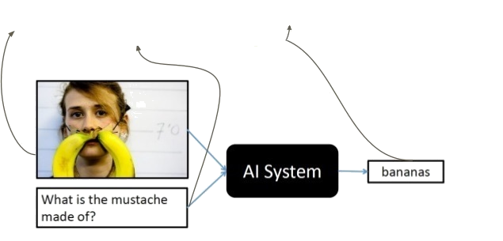
Introduction​
Question-Answering
Visual
Predict the Answer of a given question related to an image.
4

Slide 5
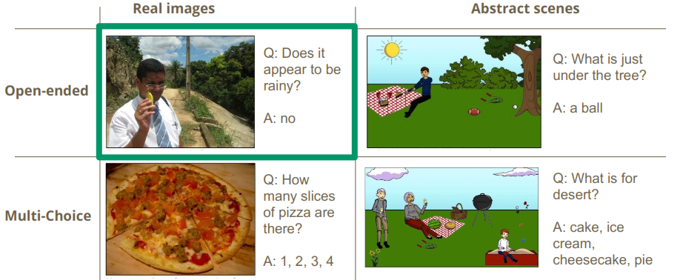
Types of Visual Question-Answering
5

Slide 6
Outline
Introduction
Problem definition
6

Slide 7
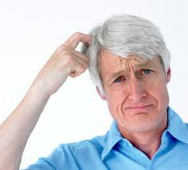
Problem definition
How to build a model that extract feature of an image related
to a given question ?
7

Slide 8
Outline
Introduction
Problem definition
Working Phases
8

Slide 9
Phases Diagram
Data Preprocessing
Model Building
Model Testing and Validation
Model Interface
9

Slide 10
Phases Diagram
Data Preprocessing
10

Slide 11
Phases overview | Data preprocessing
Gathering Datasets
VQA Dataset
6,141,630 question-answers pairs.
COCO-QA Dataset
78,736 questions.
123,287 images.
Answer types including yes/no, number, and other.
184,612 images.
4 types of questions: object(70%), number(7%) , color(17%) , location(6%)
11
Notes:
COCO-QA:
Automatically generated from image captions.
123287 images
78736 train questions
38948 test questions
4 types of questions: object, number, color, location
Answers are all one-word.
91 category for train images
VQA:
248,349 training questions
121,512 validation questions
244,302 testing questions
101,434 test images

Slide 12
Phases overview | Data preprocessing
Preparing Dataset
Text
Cleaning the dataset using NLTK.
Apply one hot-encoding for a given question.
Images
Normalization
12

Slide 13
Phases overview | Data preprocessing
Apply one hot-encoding for a given question (eg. “how many horses are there”):
[1, 0, 0, 0, 0] = how
[0, 1, 0, 0, 0] = many
[0, 0, 1, 0, 0] = horses
[0, 0, 0, 1, 0] = are
[0, 0, 0, 0, 1] = there
13

Slide 14
Phases Diagram
Data Preprocessing
Model Building
14

Slide 15
Phases overview | Model Building
Question
Word Embedding
Question Hierarchy
Co-Attention
Encoding for Predicting Answers
Image
CNN
Image Feature
15

Slide 16
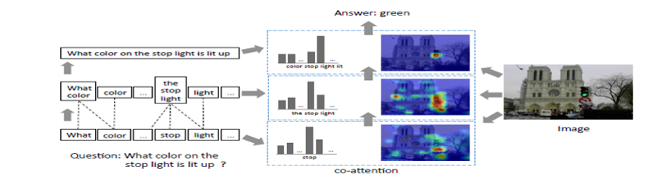
Phases overview | Model Building
Model over view
16

Slide 17
Phases overview | Model Building
Model over view
Words Level
16

Slide 18
Phases overview | Model Building
Model over view
Words Level
Phrases Level
16

Slide 19
Phases overview | Model Building
Model over view
Words Level
Phrases Level
Question Level
16

Slide 20
Phases overview | Model Building
Question
Image
17

Slide 21
Phases overview | Model Building
Question
Image
CNN
Image Feature
18

Slide 22
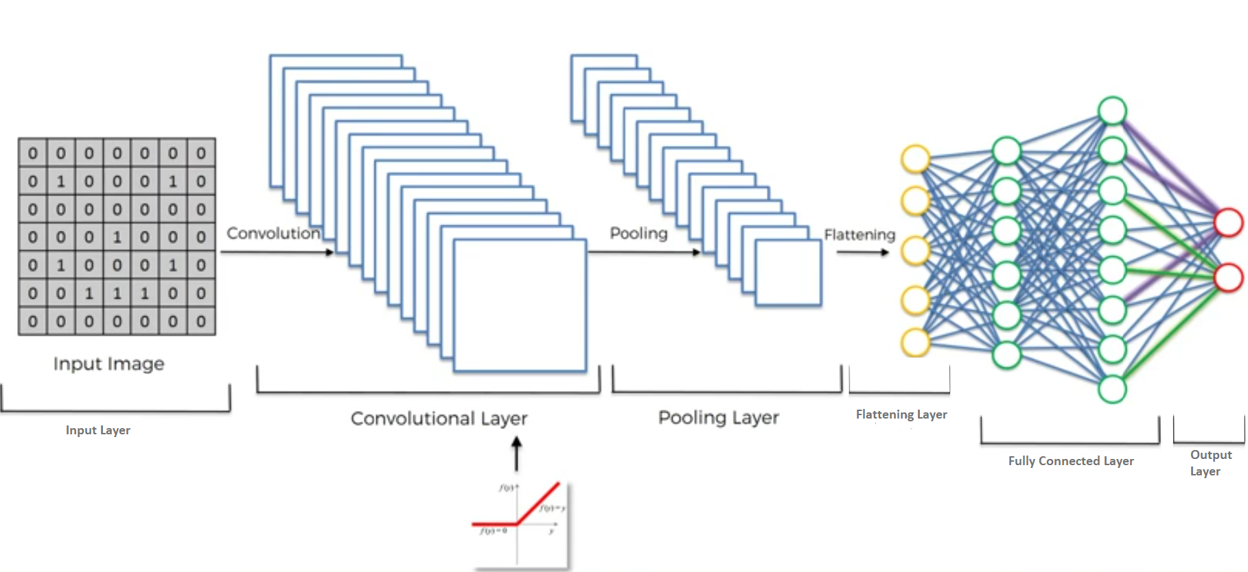
Phases overview | Model Building
Features Extraction of the image.
CNN Hierarchy
19

Slide 23
Phases overview | Model Building
Features Extraction of the image.
CNN Hierarchy
19

Slide 24
Phases overview | Model Building
Features Extraction of the image.
CNN Hierarchy
19

Slide 25
Phases overview | Model Building
Features Extraction of the image.
CNN Hierarchy
Non-Linear Function (RELU)
19

Slide 26
Phases overview | Model Building
Features Extraction of the image.
CNN Hierarchy
19

Slide 27
Phases overview | Model Building
Features Extraction of the image.
CNN Hierarchy
19

Slide 28
Phases overview | Model Building
Features Extraction of the image.
CNN Hierarchy
19

Slide 29
Phases overview | Model Building
Features Extraction of the image.
CNN Hierarchy
19

Slide 30
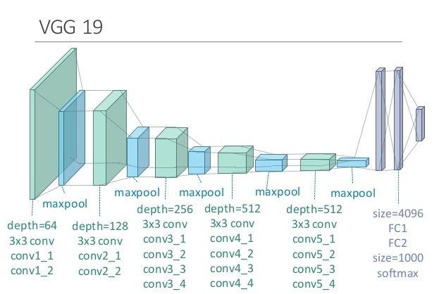
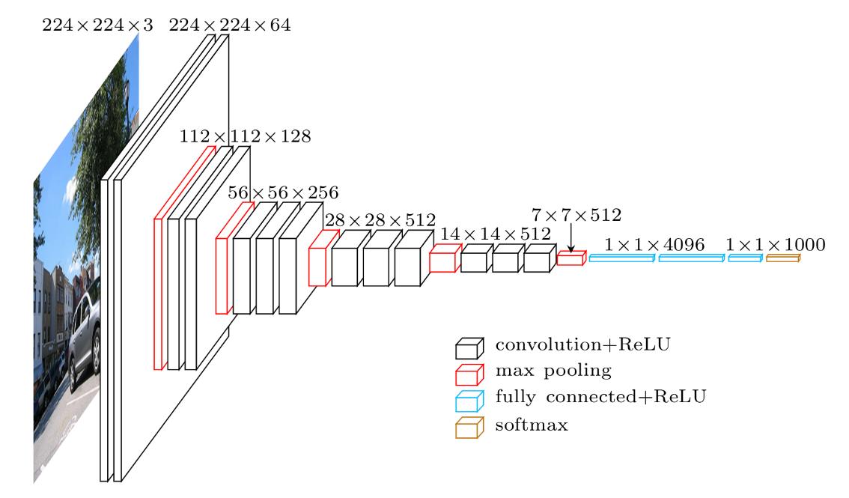
Phases overview | Model Building
Features Extraction of the image.
VGG
VGG 16
20

Slide 31
Phases overview | Model Building
Features Extraction of the image.
Our VGG
19

Slide 32
Phases overview | Model Building
Features Extraction of the image.
rescale the image.
20

Slide 33
Phases overview | Model Building
Features Extraction of the image.
rescale the image.
We input the image to VGG.
21

Slide 34
Phases overview | Model Building
Features Extraction of the image.
rescale the image.
We input the image to VGG19.
We take the activation from the last pooling layer of VGG as its feature
22

Slide 35
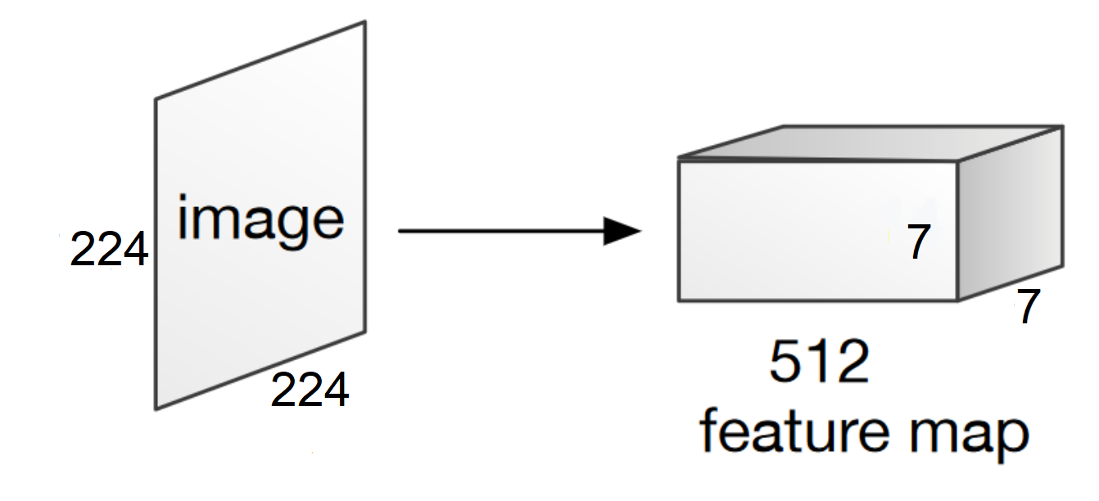
Phases overview | Model Building
Features Extraction of the image.
23

Slide 36
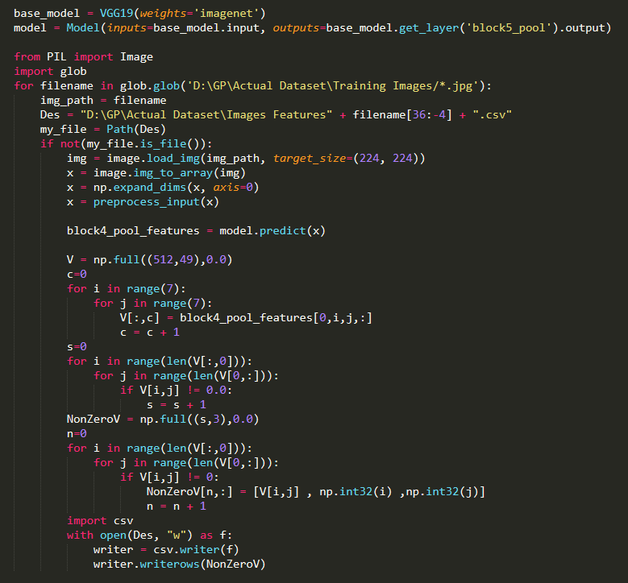
Phases overview | Model Building
Features Extraction of the image.
24

Slide 37
Phases overview | Model Building
Question
Word Embedding
Question Hierarchy
Image
CNN
Image Feature
25

Slide 38
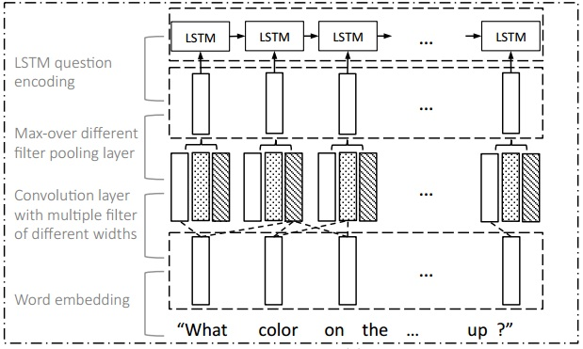
Phases overview | Model Building
Question Hierarchy
26

Slide 39
Phases overview | Model Building
Question Hierarchy
Word Level
27

Slide 40
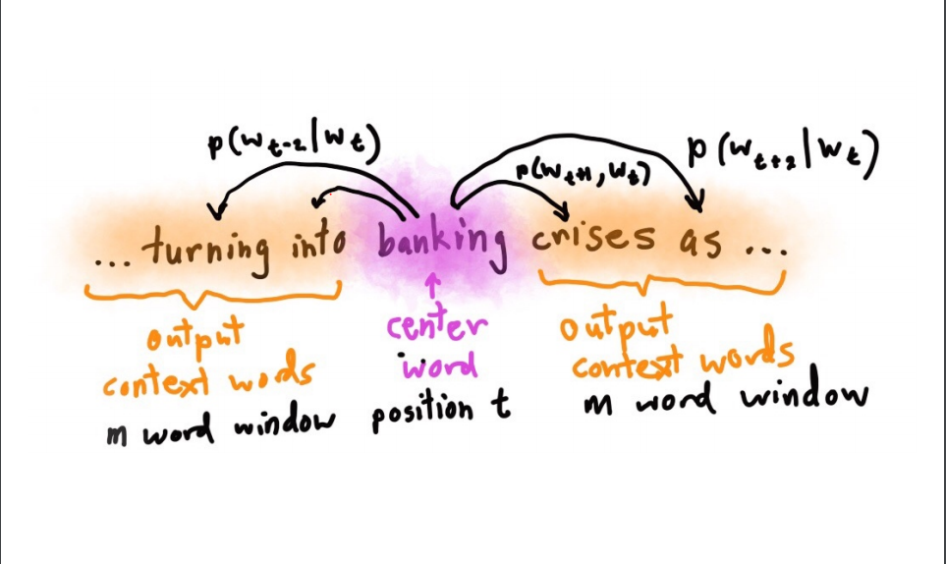
Phases overview | Model Building
Question Hierarchy
Word Level
Word embedding : A technique to embed the words to vector space , so that the words which have similar or close meaning have close vectors .
Word embedding Models
28

Slide 41
Phases overview | Model Building
Question Hierarchy
Word Level
Phrase Level
29

Slide 42
Phases overview | Model Building
Question Hierarchy
Phrase Level
To compute the phrase features , we apply 1-D convolution on the word embedding vectors
The convolution and max-pooling processes exploit and summarize the local relation signals between consecutive words.
max-pooling layer :
is utilized to extract most informative features from among convolutions
30

Slide 43
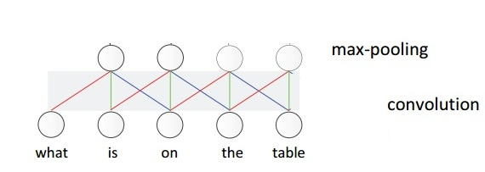
Phases overview | Model Building
Question Hierarchy
Phrase Level
The meaningful composition “ on the table” is more likely to be pooled out, compared with the composition “on the”.
31

Slide 44
Phases overview | Model Building
Question Hierarchy
Phrase Level
The meaningful composition “on the table” is more likely to be pooled out, compared with the composition “on the ”.
32

Slide 45
Phases overview | Model Building
Question Hierarchy
Phrase Level
The meaningful composition “on the table” is more likely to be pooled out, compared with the composition “on the”.
33

Slide 46
Phases overview | Model Building
Question Hierarchy
Phrase Level
The meaningful composition “on the table” is more likely to be pooled out, compared with the composition “on the ”.
34

Slide 47
Phases overview | Model Building
Question Hierarchy
Word Level
Phrase Level
Question Level
35

Slide 48
Phases overview | Model Building
Question Hierarchy
Question Level
We use a LSTM to encode the sequence of phrase level after max-pooling. The corresponding question-level feature is the LSTM hidden vector at time t.
36

Slide 49
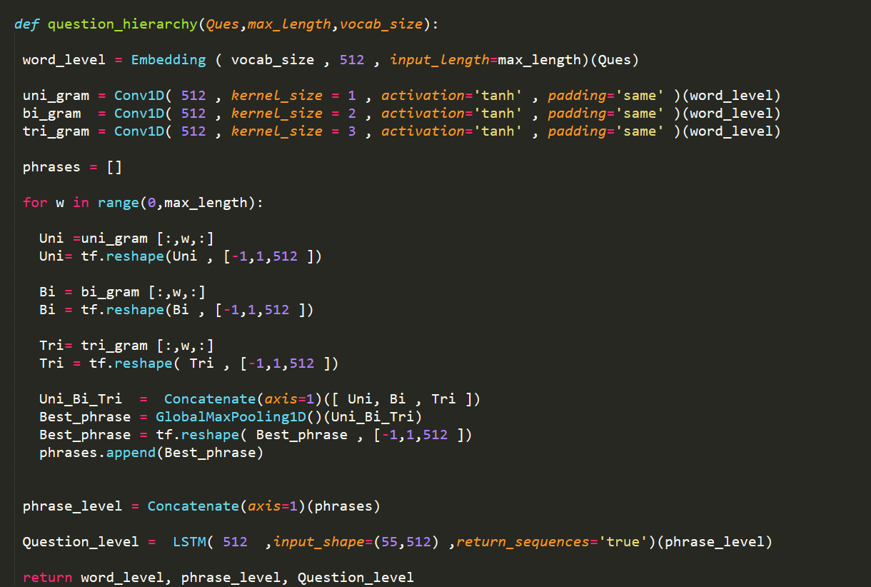
Phases overview | Model Building
37

Slide 50
Phases overview | Model Building
Question
Word Embedding
Question Hierarchy
Co-Attention
Image
CNN
Image Feature
38

Slide 51
Phases overview | Model Building
Attention
Visual attention : Based on text, which spatial location at image should we look at
Question attention : Based on image, which part of the question should we look at
Co-attention : applying both of them
39

Slide 52
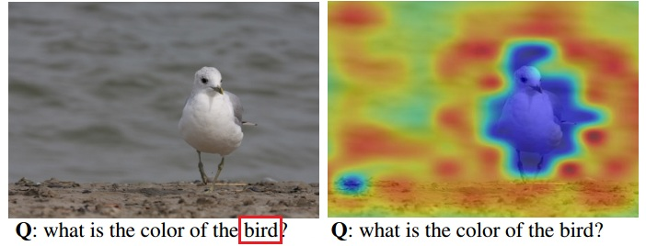
Phases overview | Model Building
Attention
Question Attention Visual attention
40

Slide 53
Phases overview | Model Building
Co - Attention
Parallel Co-Attention : Parallel co-attention attends to the image and question simultaneously, we connect the image and question by calculating the similarity between image and question features at all pairs of image-locations and question-locations
41

Slide 54
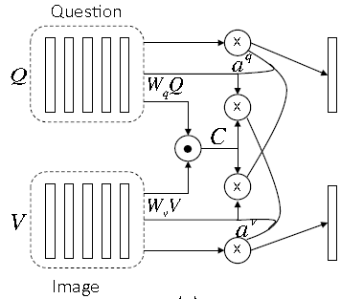
Phases overview | Model Building
Co - Attention
42

Slide 55
Phases overview | Model Building
Co - Attention
43

Slide 56
Phases overview | Model Building
Co - Attention
44

Slide 57
Phases overview | Model Building
Co - Attention
45

Slide 58
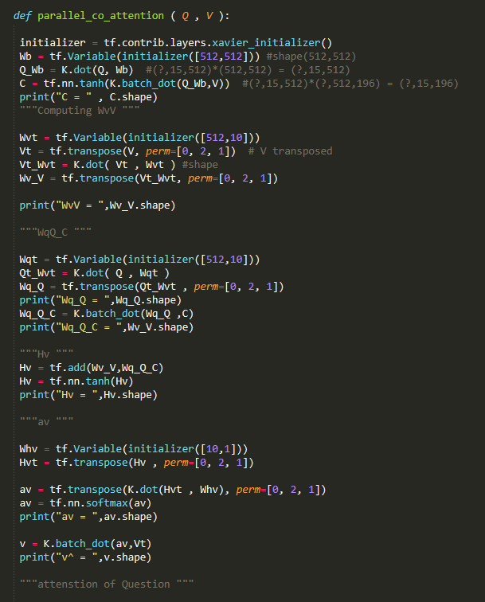
Phases overview | Model Building
Co - Attention
43

Slide 59
Phases overview | Model Building
Question
Word Embedding
Question Hierarchy
Co-Attention
Encoding for Predicting Answers
Image
CNN
Image Feature
44

Slide 60
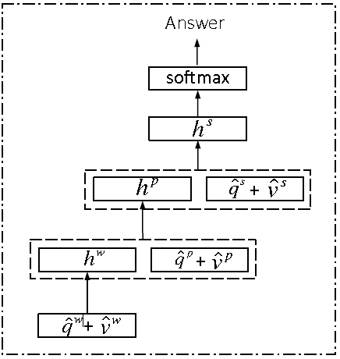
Phases overview | Model Building
Encoding for Predicting Answers
45

Slide 61
Phases overview | Model Building
Encoding for Predicting Answers
At word level obtain phrase level and enter the co-attention model to obtain attended image and question related to word
49

Slide 62
Phases overview | Model Building
Encoding for Predicting Answers
At phrase level obtain question level and enter the co-attention model to obtain attended image and question realted to phrase
36

Slide 63
Phases overview | Model Building
Encoding for Predicting Answers
At question level just enter the co-attention model to obtain attended image and question related to question
36

Slide 64
Phases overview | Model Building
Encoding for Predicting Answers
Soft max probability distribution for vocabulary
36

Slide 65
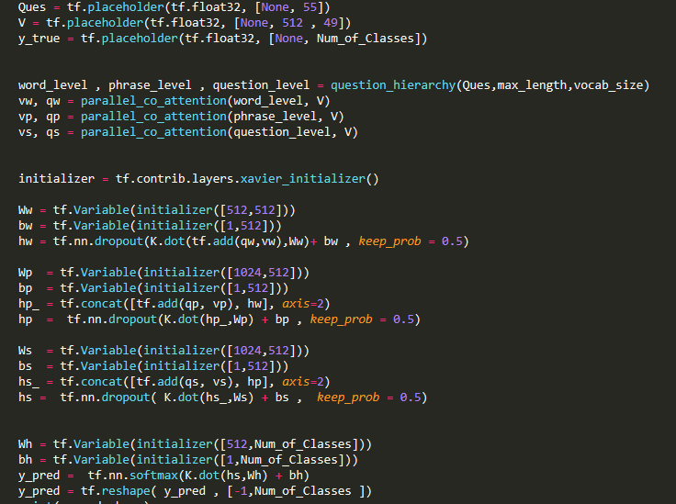
Phases overview | Model Building
Encoding for Predicting Answers
46

Slide 66
Phases Diagram
Current Stage
Data Preprocessing
Model Building
Model Testing and Validation
47

Slide 67
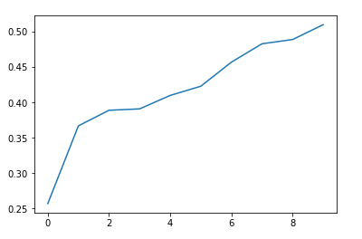
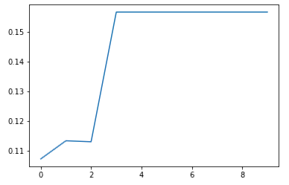
Model Testing and Validation
Vqa model:
Co-attention model:

Slide 68
Phases overview | Model Testing
Measuring the system’s accuracy and the level of correctness of the predicted answers.
Enhancing the accuracy by experimenting different types of convolutional neural network to extract the image features
38

Slide 69
Phases Diagram
Data Preprocessing
Model Building
Model Testing and Validation
Model Interface
48

Slide 70
Phases overview | Interface
Build a user interface for the system, which allows the user to interact with the system.
Using Python’s framework with CSS and Javascript (optional).
40

Slide 71
Outline
Introduction
Problem definition
Working Phases
Progress
49

Slide 72
Progress
Stages finished:
Learning deep learning and basic NLP concepts.
Data Preprocessing
Features Extraction
Model Implementation
Current Stage:
Model Testing and Validation.
50

Slide 73
Outline
Introduction
Problem definition
Working Phases
Progress
Problems faced
51

Slide 74
Problems faced
Dealing with large image datasets.
Qualified computer for training our model (Microsoft Azure Cloud)
Extracting images’ features from deep CNN
52

Slide 75
Outline
Introduction
Problem definition
Working Phases
Progress
Problems faced
Time Plan
53

Slide 76
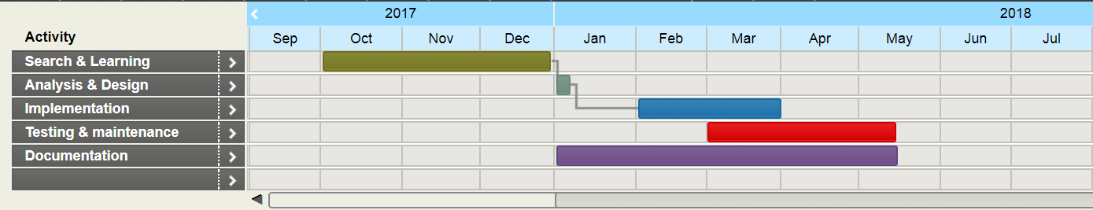
Time Plan
54

Slide 77
Outline
Introduction
Problem definition
Working Phases
Progress
Problems faced
Time Plan
References
55

Slide 78
References
Chenyue Meng and Yixin Wang, “Image-Question-Linguistic Co-Attention for Visual Question Answering”, 2016.
Alisha Rege and Payal Bajaj C, “From Vision to NLP: A Merge”, 2017.
Ronghang Hu and Jacob Andreas and Marcus Rohrbach, “Learning to Reason: End-to-End Module Networks for Visual Question Answering” , 2017.
Jiasen Luand Jianwei Yang and Dhruv Batra , “Hierarchical Question-Image Co-Attention for Visual Question Answering” , 2017
56

Slide 79
Questions
57

Slide 80
Thank You!
58

